Slide 1
History Heroes Term 1, Week 1
https://www.youtube.com/watch?v=lXgkuM2NhYI 0.50-1.00

Slide 2
Question 1
What is the period of study (years) we are looking at for unit 1?

Slide 3
Question 2
What are the four types of assessment in modern history?

Slide 4
Question 3
What economic system do we look at when studying American history?

Slide 5
Question 4
What years did the American civil war begin and end?

Slide 6
Question 5
The years between 1870-1890 are known as the _________ Age in American history.

Slide 7
ANSWERS

Slide 8
Question 1
What is the period of study (years) we are looking at for unit 1?
1907–1941

Slide 9
Question 2
What are the four types of assessment in modern history?
Historical inquiry, explanation (essay), source analysis, examination

Slide 10
Question 3
What economic system do we look at when studying American history?
Capitalism

Slide 11
Question 4
What years did the American civil war begin and end?
1861 – 1865

Slide 12
Question 5
The years between 1870-1890 are known as the _________ Age in American history.
The Gilded Age

Slide 13


Source
of
the
week!

Slide 14
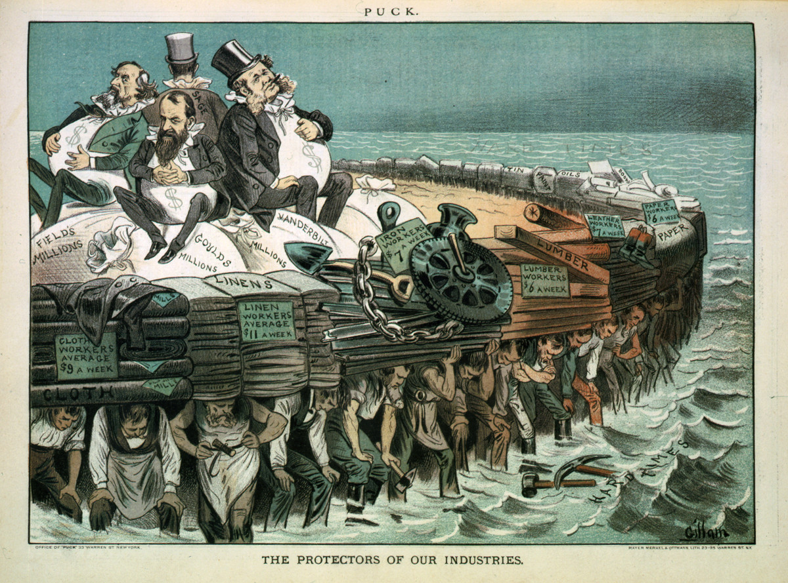
Title: The protectors of our industries
Creator(s): Gillam, Bernhard, 1856-1896
Date Created/Published: N.Y. : Published by Keppler & Schwarzmann, 1883 February 7.
Summary: Cartoon showing Cyrus Field, Jay Gould, Cornelius Vanderbilt, and Russell Sage, seated on bags of "millions", on large raft, and being carried by workers of various professions.
https://www.loc.gov/pictures/item/94507245/

